Slide 1
Proposed Methodology: Robust SOH Estimation Framework using AE-BPNN and Transfer Learning
台灣科技大學 AI所
指導教授： | 羅一峰 博士
學生： | 林志龍 (M11452803)
Scientific Reports (2025) 10.1038

Slide 2
Outline
Identifying the Gaps
Model Selection: AE-BPNN & Denoising Concept
Proposed Experiments (3 Scenarios)
Open-Source Data Strategy
Tentative Project Roadmap

Slide 3
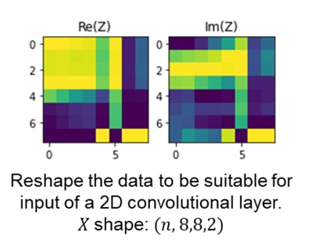
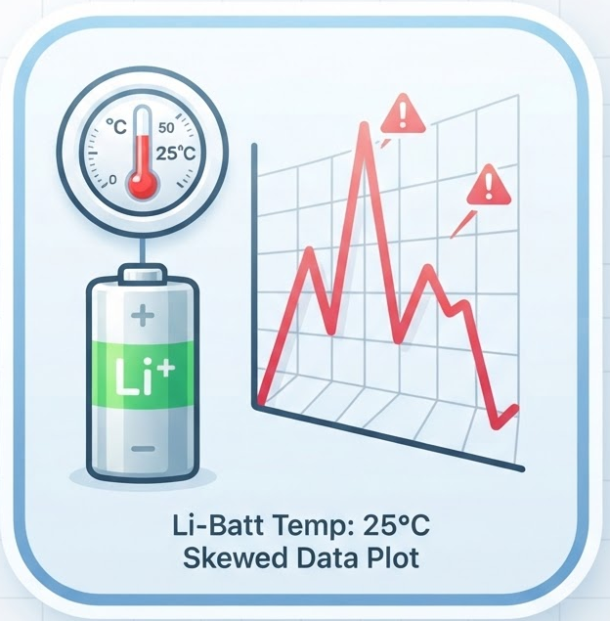
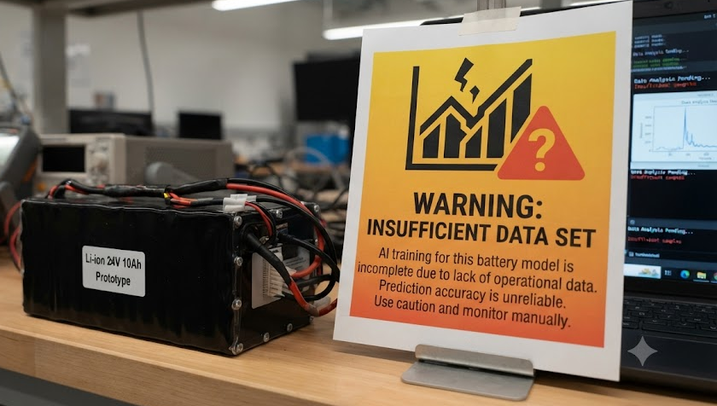
Identifying the Gaps
Limited Scope: Most existing reviews focus solely on single-cell estimation.
Information Loss:
Issue: 60 frequency points compressed into an 8×8 matrix.
Impact: Significant loss of spatial correlation and dimensional details.
Data Scarcity:
Issue: Limited laboratory dataset (Only 8 coin cells).
Impact: High risk of model overfitting and limited training capability.
Imbalanced Temperature:
Issue: Data is heavily biased towards 25°C.
Impact: Poor generalization for real-world varying temperature conditions.

Slide 4
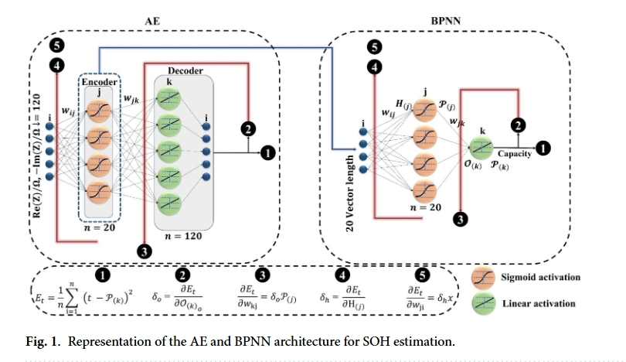
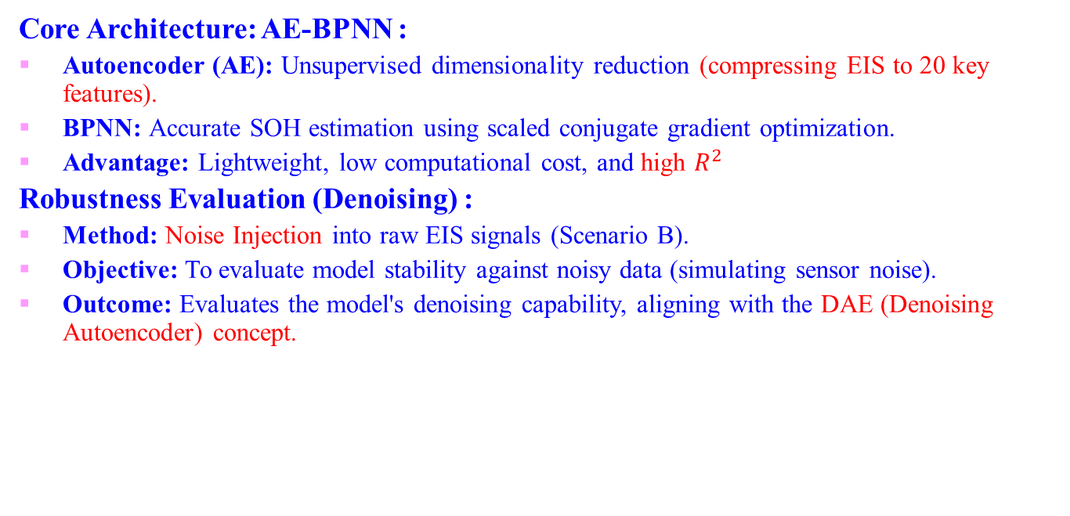
Model Selection
Core Architecture: AE-BPNN :
Autoencoder (AE): Unsupervised dimensionality reduction (compressing EIS to 20 key features).
BPNN: Accurate SOH estimation using scaled conjugate gradient optimization.
Advantage: Lightweight, low computational cost, and high $R^{2}$
Robustness Evaluation (Denoising) :
Method: Noise Injection into raw EIS signals (Scenario B).
Objective: To evaluate model stability against noisy data (simulating sensor noise).
Outcome: Evaluates the model's denoising capability, aligning with the DAE (Denoising Autoencoder) concept.

Slide 5
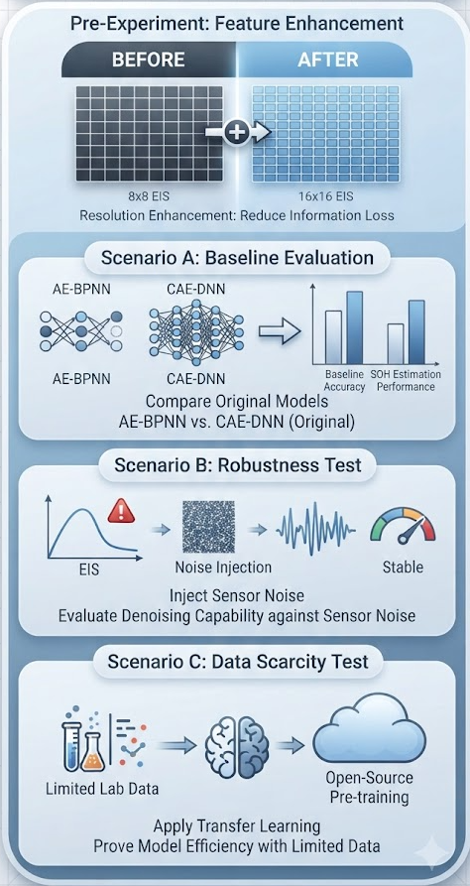
Proposed Experiments
Pre-Experiment: Feature Enhancement
Upgrade: Enhance EIS image resolution from 8×8 to 16×16.
Goal: Reduce information loss before model training.
Scenario A: Baseline Evaluation
Test: AE-BPNN vs. CAE-DNN (Original).
Metric: Baseline accuracy and standard SOH estimation performance.
Scenario B: Robustness Test
Test: Inject simulated noise into EIS signals.
Goal: Evaluate stability and denoising capability against sensor noise.
Scenario C: Overcoming Data Scarcity
Test: Apply Transfer Learning.
Goal: Prove model efficiency using limited lab data combined with open-source pre-training.

Slide 6
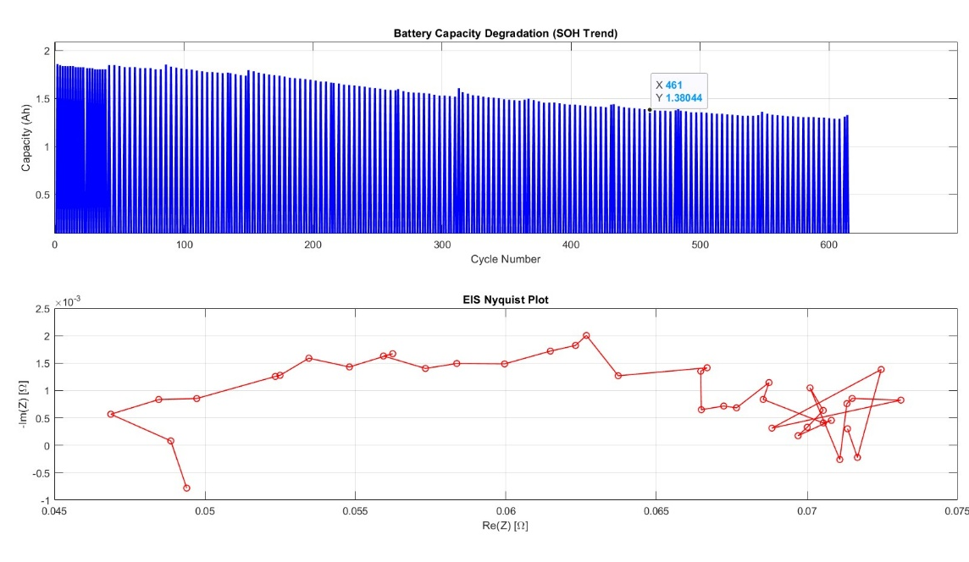
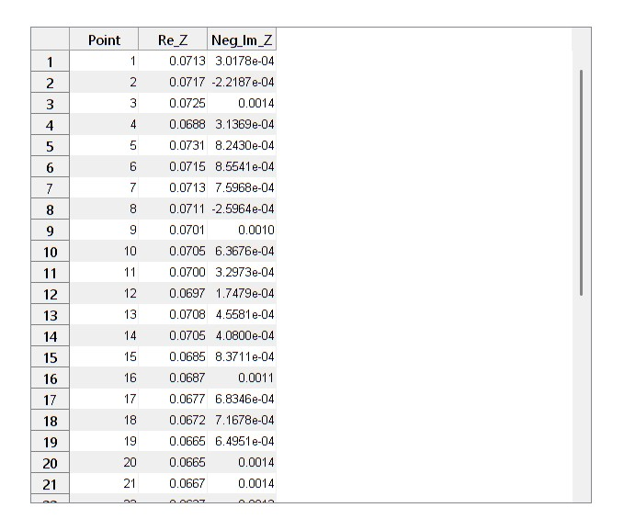
Open-Source Data Strategy
Public Dataset for Pre-Training :
Source: NASA Prognostics Center of Excellence (PCoE).
Data Type: Includes Impedance (EIS) measurements.
Features: Provides both Re(Z) and -Im(Z) values matching our required format.
Implementation Plan :
Phase 1: Pre-train AE-BPNN using extensive NASA data.
Phase 2: Fine-tune the model using the 8 coin cells from our laboratory.
Advantage: Immediate start on coding & model architecture without waiting for new lab experiments.
Figure : Data Extraction from MATLAB ( BatteryAgingARC-FY08Q4 B0005 )

Slide 7
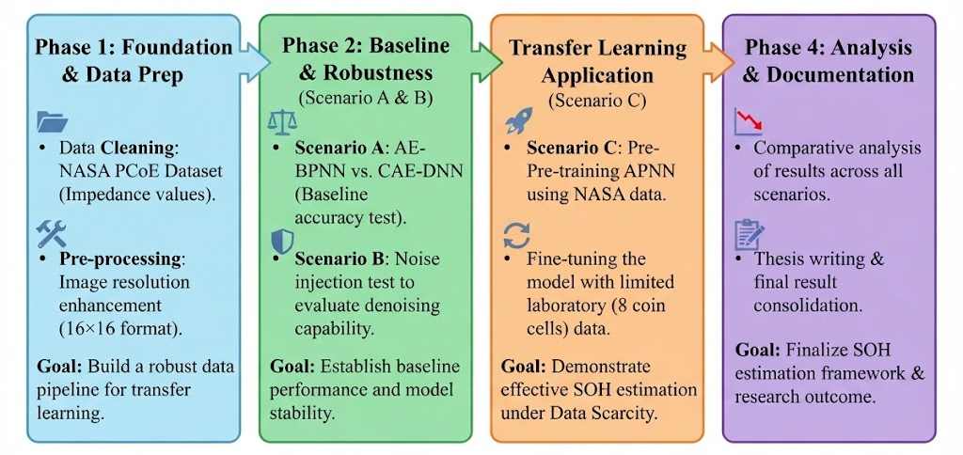
Tentative Project Roadmap

Slide 8
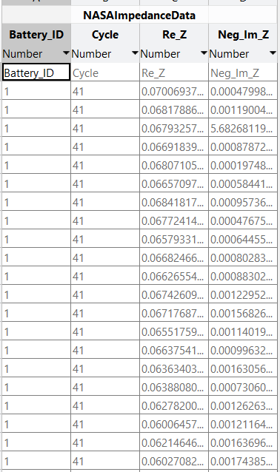
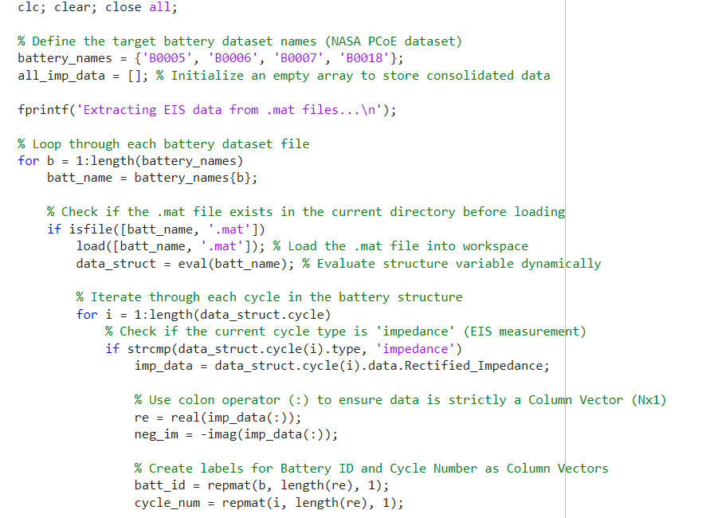
Progress: Data Extraction & Consolidation
Automated Data Pipeline (MATLAB)
Source: NASA Prognostics Center of Excellence (PCoE).
Scope: Extracted EIS data simultaneously from 4 baseline cells (B0005, B0006, B0007, B0018).
Features Extracted: Battery_ID, Cycle, Re_Z, and Neg_Im_Z.
B0005 = Battery_ID 1, B0006 = Battery_ID 2, B0007 = Battery_ID 3, B0018 = Battery_ID 4
File Format .csv

Slide 9
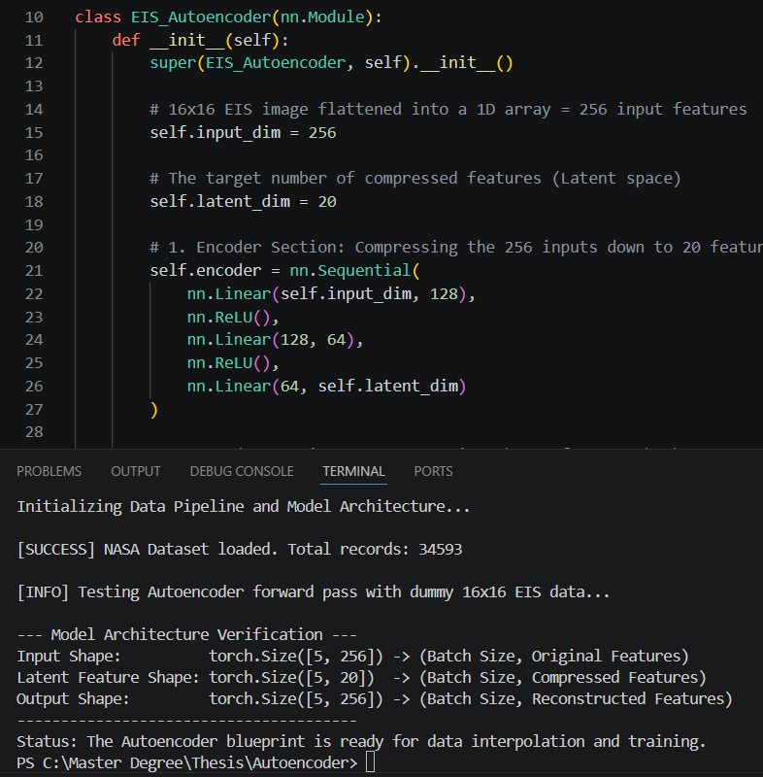
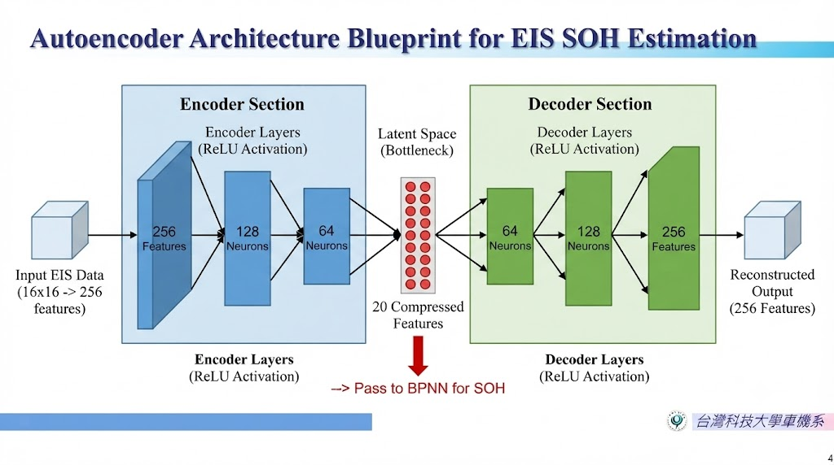
Proof of Concept: Architecture Verification

Slide 10
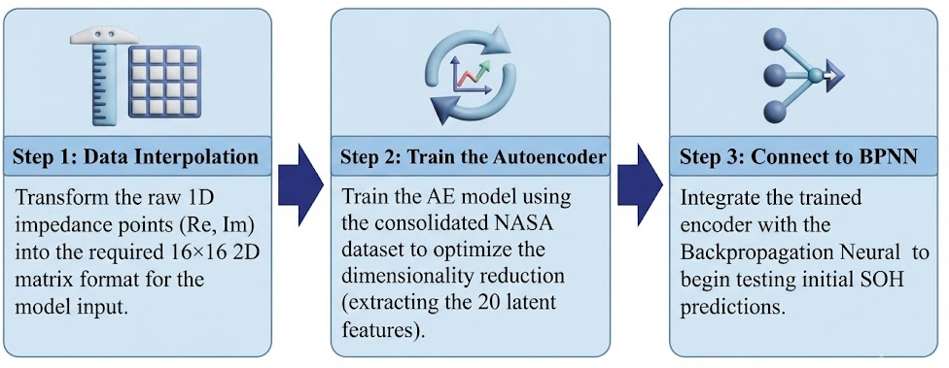
Immediate Next Steps
Phase 1: Foundation and Data Prep

Slide 11
Scientific Reports (2025) 10.1038
Thank you
Notes:
實驗平台由 Arbin 的 LBT 系列 電池充放電測試儀、高低溫試驗箱，以及一台主控電腦組成

